Slide 1
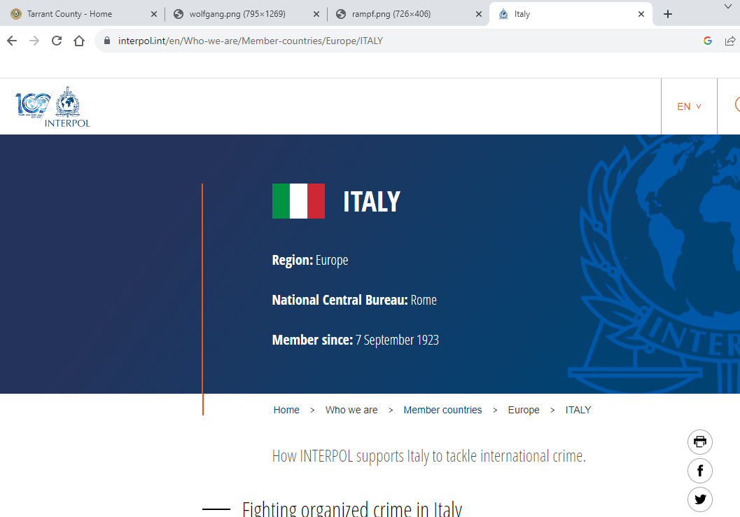
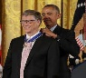
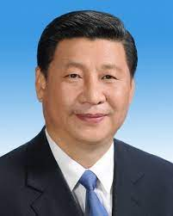
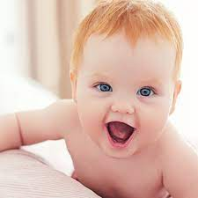
SQ.AIRFIELD.INT.HOMICDIE:2Y
FBI
Partner
Development
Slppeing out side as action herion user
G.GOD.VIRGINA.MARY
8th
!IN
PRESIENT.!AVABILITY.41
POLICE CHISTMATAS §Prostation LAW 2am
1993/4
KING(principal)
88th
VP GERMANY.DEA(herion)
Daniel,florian
Version 1.2
8th Floor
Gov Schw
Truck Driver(unimog)
IPX KA-Nort KA-South
Kit.Secratary of State
Kit.St. Francis
Avg.nonPolicePersion.nonPolcieReport
INTERPOL(ITALY)
1990, 1990
docs
Angela
8th Floor
RHEIN-MAIN anglea
8th floor
? Hertie. Infant dpemetn
CPVA.HOCME:2Y
1994 G.USD then !G.USD
Person killed HOMCIDE:2Y for Religious crimes Jesus or Apposlbet St. Peter from Muslims
1997
G.USD then G.USD
FBI:WMD for Olmpics
2014
V2:FBI:KIDNAPPING: Person kidnapped for Religion crimes of Jesus or apostle Peter from Muslims
CHART
St. Fracis
Stanford.Macedina
Alen Greean.marx(medselac)
PREA.§187.CPVA
(butthoule touch).St Francis
BACKUP(boy)
USAGE
Gabriel
Pankau, Germany
1992
2014
Visa
CHECKPINT CHALRIE
SECURITY
2026
FRANCE
V2.FBI:KIDNAPPIGN x/y (delta steve/joe) 1st visit 1992/1991
1991 Was in Los Angelsf or 9 months
1991 February
Ddr spy ricardo wall hoppers; famly, you can see wall from their windw on 8th floor
Firetrucks 9:58AM

Slide 2


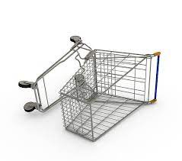

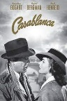
HOMICIDE:2Y DETAILS
FBI
Partner
Development
Slppeing out side as action herion user
Shopping Cart
ICC.marx(putin)[]
CPVA.§187.PREA
ATOMCLOCK(LAKE TAHOE)
VIRIGINA.MARY
v2:FBI:KIDNAPPING
1900,1945,2014
HOMICIDE:UR_UR_OPI
8th Floor.angela.kit.St. Francis
KING Gustav-Nachtigal-Strasse
HOMICIDE:2Y Turkish, Male 16-18 Afganani? Dark Skin
Freiburg, Baden-Weurtemberg
Thomas-is-dieter: Wieland
Marriage Noodles, Drive to Switzerland: Eva Bran and Dr. Dieter Zetsche to buy
Passign Freiburg
DEA(mdma), Freiburg Evo Khaterikis, kit, -> phil/kim ( Philip dr)
(HOMICIDE:AUSLAENDER)
A5
FBI.marx(Angela.adam.corny)
0.1 Story:HOMICIDE:JESUS:16[]
VIRIGINA.MARY
1996/7
2014 SQ.SF joyti afgani,darksin
Telmat, Joephse Flight leave coutnry
Mary Reynolds, SQ.AIRFIELD
docs
0.1 Pope.PAUL: DEA(schwazer afgani canibis)
VIRIGINA.MARY
1993/4
Mary Reynolds, PAUL
docs
1994
CAR HOMICDIE:LUX
000.marx
1993 Stanford
1981
1992 September 11th
000.marx
German Male
Peter
VIRIGINA.MARY
1992
Age 12
Angela.St. Martin.flea[0]
Mary Reynolds
Pentagon Base Paul
“Teacher”
1968
Born in 1945

Slide 3
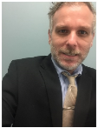

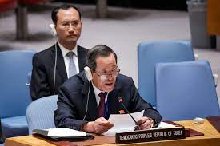
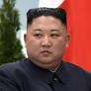
HOMIDE:2Y PLANNING DOCUMENTS
FBI
Partner
Development
Slppeing out side as action herion user
G.Gott.CPVA.v2.FBI:KIDNAPPING
docs
FBI:INT:WMD:G.INT.(USD).WHITEHOUSE
Will he make it?
1983
SQ.AIRFILED.1996
Baby brother
docs
Renyolds
He made it
Sin?.Ronald Regan.nonPolicQOS.1st child
1990 The baby will die in 4 years with SQ.AIRFILED
Mary Reynolds will live in SQ.AIRFIELD, synthetic transaction (parallel) 1996/7
1990 He will live in SQ.AIRFIELD in 1996/7 before MAINSTREET(hauptstrasse) 1997/8
2004 VP GERMANY, PENTAGON.emea.deere(HOMCDI:IS-A-BELL,basf) CONSTITOIN violations PENTAGON.emea
2005 He will leave roth.ibm.damiler.*
2010 ATOMCLOCK
2014 CPVA IPX 1992
2023 ICC.marx(putin)
2000 WAR.LARRY.SQ.NEWSPAPER(PREA)
B/10 to Whiteouse.LARRY
PETER
simon
CONSITUTION: Soviet union, ICC.russia.marx(putin)
!white
2023
v2:FBI:KIDNAPPING
PRE
LIVE
nonPoliceLisnters: FBI spy ring max planc
FBI:WMD phil/kim ddr ricardo
https://www.fbi.gov/history/famous-cases/duquesne-spy-ring
Level: not our network(us !de) black at work
Roth.ibm.dmier.*
!LABOR CODE KOCHEMAN
KOCHMENA.marx(cypress) Steve.meiers@gmail.com
Angela julianfishan@google.com,0.1 gohceoh(micehaal.wieelan@gmail.com)
POST
Marx(lisnter: desk4_right COURT montring layout FBI spy ring max planc

Slide 4
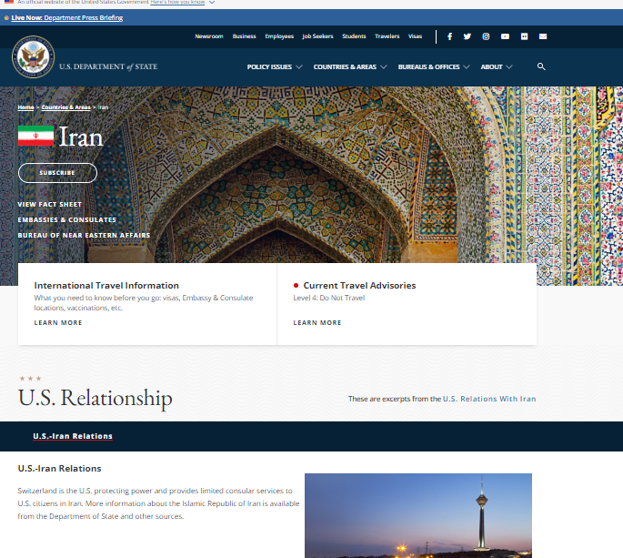
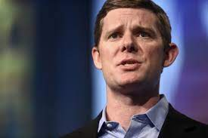
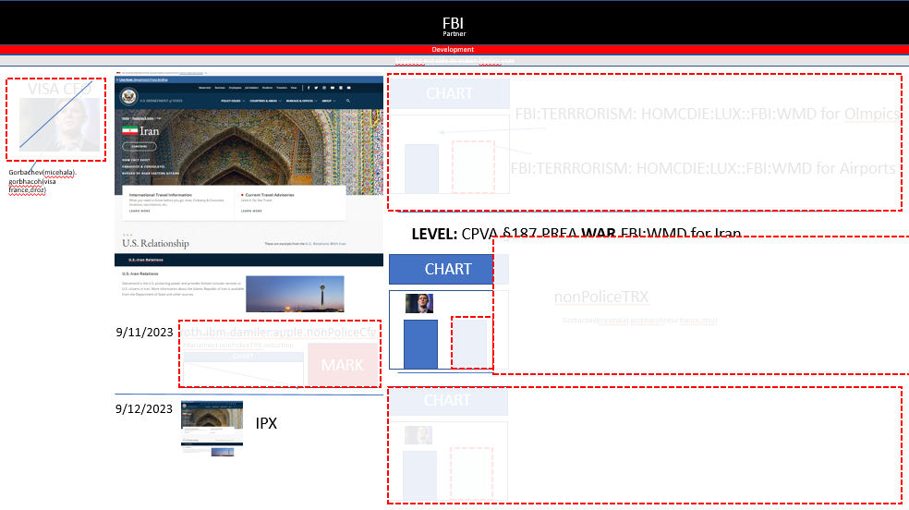
FBI:TERRORISM IRAN
FBI
Partner
Development
Slppeing out side as action herion user
VISA CEO
CHART
FBI:TERRRORISM: HOMCDIE:LUX::FBI:WMD for Olmpics
Gorbachev(micehala).gorbhacoh(visa france,droz)
FBI:TERRRORISM: HOMCDIE:LUX::FBI:WMD for Airports
ATOMCLOCK
nonPolciespanish
LEVEL: CPVA.§187.PREA WAR.FBI:WMD for Iran
CHART
nonPoliceTRX
9/11/2023 roth.ibm.damiler.apple.nonPoliceCfg
Gorbachev(micehala).gorbhacoh(visa france,droz)
Manament nonPoliceTRX reduction
MARK
CHART
CHART
9/12/2023
IPX

Slide 5

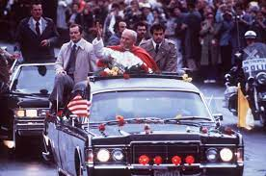
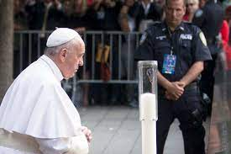

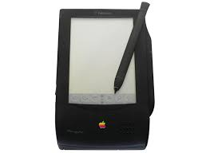
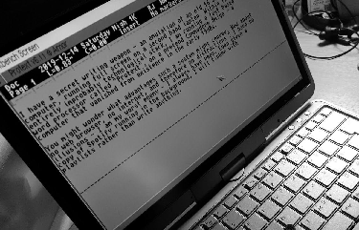
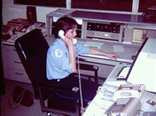
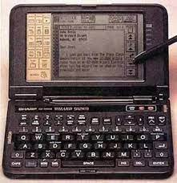
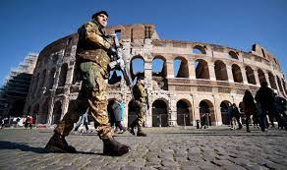
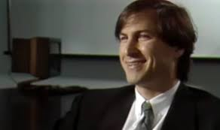
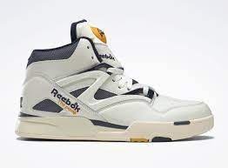

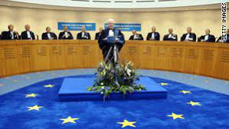
CHECKPOINT CHARLIE(1990)
FBI
Partner
Development
Slppeing out side as action herion user
ICC.marx(putin)
DEBORAH
julianfishan@google.com,0.1
Meiers/meiers
angela
0.01 fine FBI:WMD level VIRIGNIA
nonPolicTurkish.BLACK
Heusenstammerallee
Phil/kim
Roth.ibm.dmiler.apple.pda
ID.pda
RHEIN-MAIN
CHECKPOIN CHALR(chanzlor)
tonsek
CHECKPOTN CHARLEI(HOMCIDE:AUSLAENDER)
tonsak
Roth.ibm.dmier.apptl.touch
WW2.CIVIL CODE
(Father: asyml seaekr)
Stephanie: father of all students
!github
1990
Rebook pump
At&t Partner
2017 Foster City rebook pump, UPS,
v2
WAR IN YUGSLAVIA
TURKEY CONSITITION
Bosnia-Herzigovina Consitution, Muslim
LARRY what are we doing here Karlruhe? FEDERAL CONSTITON COURT
11:51AM COURT CASH REGISTER
CHECKPOIN CHALR(chanlor)

Slide 6
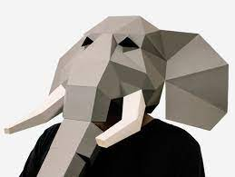
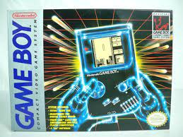
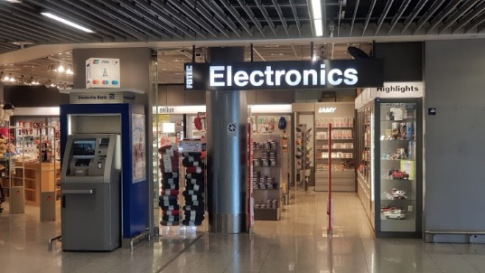
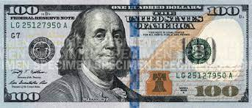
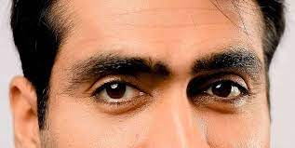
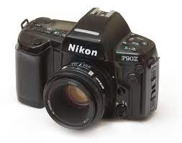
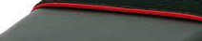
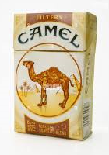
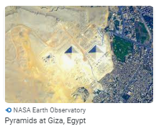
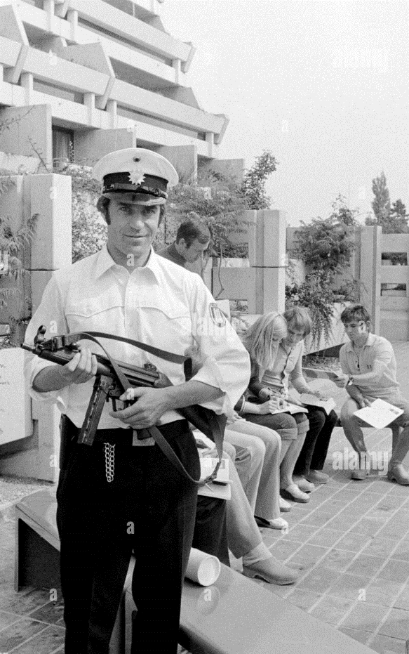
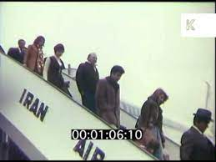

CHECKPOINT CHARLIE(1990)
FBI
Partner
Development
Slppeing out side as action herion user
CHECKPONG CHARLIE(ELECTRONIC,RHEIN-MAIN)
1988
1989
1990
RHEIN-MAIN
ATOMCLICK(rhein-min.KOCHMENA)
Elephant in Pocelin Store
RHEIN-MAIN
Phil/kim
RHEIN-MAIN
ATOMCLICK(github:.KOCHMENA)
DE:INT:FRA
KOCHEMAN
ELECTRONICS
Tonsek, tonsak
!AVABILITY(storage, JOEB)
Ciggeretes
CIVIL CODE
§HumanTraffiking
$3,000-$6,000
SEPERATOIN:31 tonsek
!gorahcei(kitio,micheaa)
1992->2014 ATOMICCLOCK(canon,Nikon)
0.1 Apt, $300,000 2007 tonsak ->2008 150,000 2010 300,000
1983 October 31st, N. Branciforte, Santa Cruz Hallow Parade
v2.FBI:KIDNAPPING
MARK
1982 October 31st, N. Branciforte, Santa Cruz Hallow Parade
FBI:WMD for Olmpyics
1981 October 31st, N. Branciforte, Santa Cruz Hallow Parade
ATOMCLOCI(FBI:WMD).WHITEHOUSE
2008-2016,2023 MARK
Takre 02 apple leaving
Stoper leaign, cecil moding leaving
Metin leaving

Slide 7
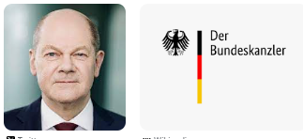
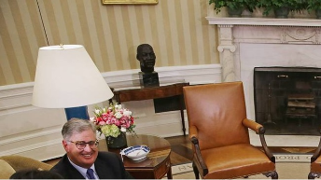
nonPoliceHomelessLiason - Capability
FBI
Partner
Development
Slppeing out side as action herion user
HOMCIE:IS-A-BELL
2014 PENTAGON.emea.deere.basf.CPVA ATOMCLOICK()
2024
offline
PENTAGON.emea.deere.OFFLINE J2EE Online/Offline Attachment System
DoDAF
Department of Defense Archtiecture Framework 2.1
DoD – Department of Defense; Capability to read documents offline 2024
2023 September
online
DoD – Deparment of Defense; Capabilitty to report to Government with food, sleep,clothes w/o buisness
SQ.AIRFIELD
BASF
ENTRY CHECKPOINT CHARLIE 1988,89/90
EXIT 2005
EXIT 2023 ICC.mrx(russia)putin
PENTAGON
emea
Deere
Thomas-is-deiter(russian xml translator
Agg: Thomas-is-dieter
!G.JEFF:YANKEE
2015
ATOMCLOICK(HOMICDIE:MAX-PLANK(breuer, spy))
*Known dependencies: roth.ibm.damiler.* (delta) CRIMAINAL CODE.avg

Slide 8
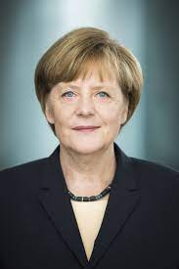

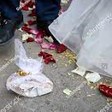
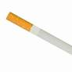
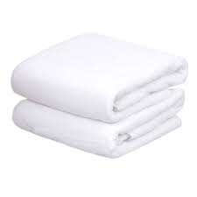
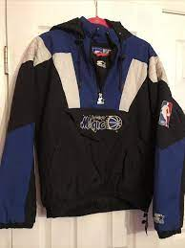
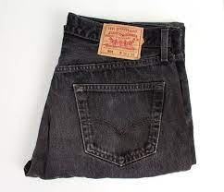
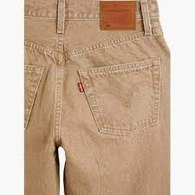
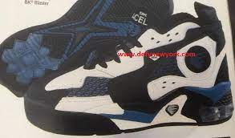
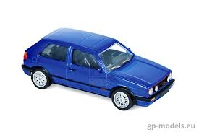

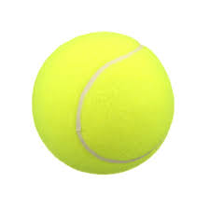
HOMCIDE:2Y SQ.AIRFIELD.INT
FBI
Partner
Development
Slppeing out side as action herion user
1996/7
KING(gustav-nactigal-str)
Phil tonsek
tansak
HEIDELBERG.MILITAYR.PARKER
VIRIGINA.MARY
1996/7
github
IPX gorbachev(micheal)
Mary Reynolds, SQ.AIRFIELD
nonPoliceMPA.nonPoliceCfg
WAR IN YUGOSLAVIA
HOMICIDE:2Y
HOMICE:AUSLAENDER
Imgrid,Eric Schmidt
Gorbachev(michelbach,gaggenau)
FBI:WMD
Afgani, !Indeis H1-B; Turkey
US-CA-DL.avg: $130,000
Angela/o
MANAGEMENT
Sasha
?
1996
Asylum:Father[]
?1994/5
Stefan
1997
G.VIRGINIA
000.nonPolicMuslim.marx(sin)
MILITARY
!HOMCIDE:AUSLAENDER.sin
1999 roth.*tsv
HEIDELBEG
St. Patrik-Henry
x
Gorbached(micheal
IPX PAUL.St.Francis.St. Gabrieel redhair/US
MILITARY
St. Patrik-Henry
G.kischhsime(trnal)cherrytown HEIDELBERG
IPX.DEA(!herion).VIRGINA.”kevin”
HOMCIE:LUX:LV-SFO-FRA $25,000
§Theft
!§Theft 2016 Stefan/Stefan/stefan
Process to open lock vw air suction tennis ball

Slide 9

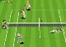

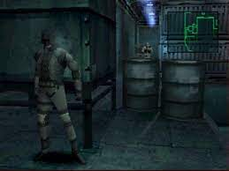
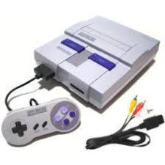
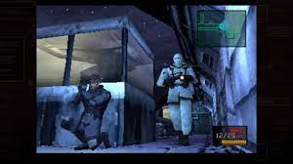
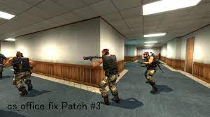















MILITARY HEIDELBERG St. Patrick Henry Village – Super Nintendo
FBI
Partner
Development
Sleeping in Raid
Slppeing out side as action herion user
1995/6
4th Floor Attic
IPX
GAS
Auschwitz
PENTAGON.PXSquare
VIRGIN MARY
Adam
tootsie
1995/6 MLK
2014
FBI:WMD night
HOMICDIE:IS-a-BELL office
Angela.ADAM
JOEL
PRIESION WARD
NURNBER TRAIL
Genesis
IPX HOMICE:LUX:COINTOWN 4 storye
IPX ATOCLOICM(HOMICE:LUX) §Adultry
CAR,GAS
FORT WORTH
1994/5
POLICE
FORT MYERS
Officer Chance
US.nonPolcieQOS
NADINE
Gorbache(seitz)
NADIE
PARKER
St. Patrick
Jonahten/Micheal
Yougner Brother
§181a STANFORD(PMP)
G.MLK
DEATTH BLOW
HOMICDIE:GHOST
G.FRANKLKIN.HOMCI:LUX
IPX FRANLKYN
IPX FRANLKN
PAUL.St. Francis.!agnalea.WWI.St Gabriel
G.VIRIGNA.TORT-1
MAINSTREET
HOMICDIE:JESUS♥LAVE IPX NAMECHANGE(Free) comics
2014

Slide 10







FBI:INTERNATIONAL:TERROISM – Witness Disbursement
FBI
Partner
Development
Slppeing out side as action herion user
FBI:WMD:WHITEHOUSE
CONSTUTOINA VIOLATIOSN not the same screen 1980-2023
ICC.marx(putin)
gorbachev
nonPoliceCourtLogical.employee.marx(!house)
nonPoliceChurchLogical.TV.marx(Sheldon)
docs
CHART
Roth.ibm.dmiler.*
Meiers/meiers:gor
PETERSSON
(DEBORAH)
INTERUTPS
PETERSON
FBI:INTERNATIONAL
ICC.marx(putin)
gorbachev
docs
CONSTITUION INTERUPTS
(LAW)
Roth.ibm.dmiler.*
G.VIRIGNA MARY.marx
Meiers/meiers:gorbahce(micheala)
Hiring Documents
Planning Documents
Workflow Documents
Logs
Expense Reports Restaurants
…
v2:FBI:KIDNAPPING
NAME CHANGE document
Revert NAME CHANGE doc
docs
!AVABILITY
Hiring Documents
Architecture Documents
Expense Reports Restaurants
International Moving Expense

Slide 11





FBI:TERRORISM Thomas-is-Dieter
FBI
Partner
Development
Slppeing out side as action herion user
CHECKPOINT CHARLE(Thomas Dieter)
Thomas-is-dieter:
EDEN
evabraun
Thomas-is-dieter: wieland WWI
HOMICIDE:LUX
Thomas-is-dieter: genzer
Thomas-is-dieter: HOMC:LUX

Slide 12








HOMICIDE:AUSLAENDER CHECKPOINT CHARLIE(1990)
FBI
Partner
Development
Slppeing out side as action herion user
nonPolzeiFashing(tranls)
nonPoliceHalloween
§Fraud.ID
Oil Schach
WWI
Andres Kaiser
Roth.ibm.dmiaoer.*apple.*
000.tw.pngs.St. Franci(cisco kid).St. Andrew.Tonsek(!kit)
CHECKPONG CHARLIE(CPVA oven,phi/kim)
RHEIN-MAIN
Pizza oven
Backup network engineer
Phil/kim
Phil/kim
ELECTRONICS
Ciggeretes
FBI:WMD for Olympics,&Airports
CHECKONIC CHARLIE(1990)
Tonsek, tonsak
!MLK
!AVABILITY(storage, JOEB)
Thom alisoin appel.touch known !white visa playsan
ATOMCLICK(rhein-min.KOCHMENA)
thomas—is-dieter: Wieland !bane
FBI:WMD:GREEN DUBLIN
ATOMCLICK(github:.KOCHMENA)
At home
V2:FBI:KIDNAPPING: Person kidnapped for Relgion cfeims of Jesus or apostle Peter from Muslims
CIVIL CODE
§HumanTraffiking
SEPERATOIN:31 tonsek
!gorahcei(kitio,micheaa)

Slide 13

















United Nations Children
FBI
Partner
Development
Slppeing out side as action herion user
Hit by train able/cane; able/adams
CPVA.PREA.§187 ONLINE
OFFLINE
VIRGIA
Children at IBM(INT)
1D8723.
PREA.§187
ATOMCLOCK(
)
Genetecht.Facebook
CHART
G.Genesis
nonPolcieContentItem
USAGE
Adam
JOEB
1D8723.nonPoliceUN.nonPoliceTRX
§Sgb Public Disbuance Middle finger
7:36PM
G.!Gott.LABOR CODE.INT 14h
Hit by train able/cane; able/adams – PINK high blood
eval.CPVA.PREA.§187
G.PAYMENTS
G.MAINSTREET.VIRIGNA.MARY{
CHART
nonPoliceTRX
}
JOEL
nonPoliceTRX
nonPolcieContentItem
HOMIDIE:SPY(breuer)
2008-2016
I like evythgon you like
Children at United Nations
Phil/kim
united nations north korea kim at united nations
[x]
0.1 DE angela.st martin.flea[] LOCAL
IBM.INT.1D8723
https://www.whitehousehistory.org/national-council/eula-adams

Slide 14



0.1 G.MARKPLATZ(cherbar) phil/kim KING.hendrin 4am schlemermeyer ass** licking KING.marx inside slemmern(to lick around ugly)
FBI
Partner
Development
Slppeing out side as action herion user
§PREA

Slide 15

FBI:TERRORISM nonPoliceTower
FBI
Partner
Development
Slppeing out side as action herion user
v2:FBI:KIDNAPPING ,MLK(DOUMETNS)
1990 angela.st francis
8th.floor
kit(uc davis postdr)
2009/10
G.MLK(buildiner small town)
Ibm-dns: skyscraperman.com
https://www.dangoodwin.com/
2005
IBM
tonsek
JFK(angela.roth.ibm.damiler)
September 11th
angela.8th.floor
St france kit(uc davis !post dr)
1992 gorbahce(jackson)
1994
angela.8th.floor
St france kit(uc davis !post dr)
1996
2013
Level: Ubaid Osama Bin Laden
G.God.Gott IMPORT Osana the highest
JFK(angela, berlin,kdwe)
4
Moody.jane
VIRING.phi/kim “view”
MARK
2019
CHECKPOITN CHALR
(hertie)
1997/8

Slide 16




















FBI:HOMICIDE:DOG, FBI:HOOVER:INVESTIGATION
FBI
Partner
Development
Slppeing out side as action herion user
FBI:HOOVER
MIDDLEFIELD ROAD
2020
HOMCIDE:DOG
Fort Dallas, ONSITE
PARKER tana
HOMCIDE:ITALINEN:20
9th, 13th
5th
4th
6th
7th
8th
!ESL 10Y !DSL
Adolf reichwein schule eheusenstam
4 klasse
ATOMPHYSICS
KING.apple.siri.ring.(susi,wakeup)
IPX Ss backersfiled.nonPolcTexasNA. VGGG.WW2

Slide 17













§SchulG
FBI
Partner
Development
Slppeing out side as action herion user
1996, 2014
IPX Eva Braun, Verand Wishiwashi
1992, 1994
Age 13
1992/3
Eva braun, Klassendbuch, Boad Washing(memory)
§Late 10 Minutes
§Sickday
Herr Koenig
7a
September 15
Please don’t go
I will get chalk
1992/3
Erst-Reuter-Schule, Deitzenbach
1996
St. Martin DocHolday
KING.Leopoldshafen
1994
10x10=100
10x20=200
Plus 0
10x10=100
Wisiwashi
Braun,eva
10x10=100
I will get chalk
Go home ami
Du bist do dum
(tral) you are so dumb
Court: Penny Courting

Slide 18












§Monitoring
FBI
Partner
Development
Slppeing out side as action herion user
j
KOCHEMAN: Steve.meiers@gmail.com
Gorbahce(michealea,Angela.St. Martin.flea[]): gabrielfisahn@googlemail.com
Jason.Nygel.meiers@icloud.com

Slide 19
FBI
Partner
Development
Slppeing out side as action herion user
j
KOCHEMAN: Steve.meiers@gmail.com
Gorbahce(michealea,Angela.St. Martin.flea[]): gabrielfisahn@googlemail.com
Jason.Nygel.meiers@icloud.com

Slide 20
































FBI
Partner
Development
Slppeing out side as action herion user
1986/7
1987/8
1988/9
1990/91
1st
Marlin
!ESL 10Y !DSL
ORCHESTRA
NAVY
2001/02
2002/03
2003/04
2004/05
2005/06
2006/07
2007/08
2008/09
2009/10
2010/11
2011/12
2012/16
2016/17
2017/18
2018/19
2019/20
2020-22
PRISON
Klosterweg
2nd
J-10
MONESTARY
NEW YORK
AUSCHWITZ
3rd
Hudson
Bahnhofstrasse
RHEIN-MAIN
Decoto Workcamp
Otto-Hahn-Str
4th
ATOMPHYSICS
Webster
Sept 11
INTERNET
1991/2
1992/3
1993/4
5th
6th
7th
Dr. Heus Starsse
Deerepark
CAR
PENTAGON
Carl-Benz-Strasse
Larkspur Shores
Carl-Benz-Strasse
San Quentin
CAR
Carl-Benz-Strasse
Bismakstrase
CAR
WWI
8th
8th
Rudolf-Diesel-Strasse
Middlefield Road
GAS
ARMY
MARK
CHECKPOINT CHARLIE
GAS
ATOMCLOCK
Gustav-Nachtigal-Stasase
Rudolf-Diesel-Strasse
1996/7
9th
KING
Kriesgtrasse
MAINSTREET
WEAPONS
1998/9
1999/00
2000/01
Haendelstrasse
10th
11th
12th
!WAR
Friednstrasse
ATOMBUTTON
CHECKPOINT CHARLIE
Andrews Blvd
Andrews Blvd
Sales
SYMPHONY
CITY
Apprentice
Pinebrook
2000/1
13th
WAR
FBI
Hebelstrasse

Slide 21









FBI
Partner
Development
Slppeing out side as action herion user
1986/7
1998
SYMPHONY
§Staling
§Agg Assulst
G.VIRGINA.MARY.MAINSTREET JFK(Ernaerungswissenschaftlichesgymnasium)
G.VIRGIN.MARY.St. Francis
Police Sirenes: 6:43PM
GPA:
§CRIMINAL CODE
Carl-Benz-Strasse
2.02 (B), 3.0
CAR
CIVIL CODE
Deutsch Sport
Mathematik Physik
English Chemie
Gemeinschaftskunde Biologie
Musik Technik
Bildende Kunst Erdkunde
Etik/Religion Informatik
7th
F(x)=3y+x2
nonPolice
CIVIL CODE
FBI:WMD
HOMICDIE:HANNES wife
HOMICDIE:JESUS

Slide 22


FBI
Partner
Development
Slppeing out side as action herion user
§CRIMINAL CODE
Carl-Benz-Strasse
GPA:
2.02 (B), 3.0
CAR
Deutsch Sport
Mathematik Physik
English Chemie
Gemeinschaftskunde Biologie
Musik Technik
Bildende Kunst Erdkunde
Etik/Religion Informatik
CIVIL CODE
8th
F(x)=3y+x2
nonPolice
CIVIL CODE
FBI:WMD
TORT-1
§CRIMINAL CODE
GPA:
2.02 (B), 3.0
Carl-Benz-Strasse
Deutsch 3.0 Sport 1.5
Mathematik 1.5 Physik 3.0
English 1.0 Chemie 3.0
Gemeinschaftskunde 2.0 Biologie 3.0
Musik 2.0 Technik 2.0
Bildende Kunst 2.0 Erdkunde 2.4
Ehtik/Religion 2.0 Informatik 1.0
CAR
CIVIL CODE
F(x)=3y+x2
CIVIL CODE
FBI:WMD
8th
nonPolice
7:10PM September 12th, 2023

